Slide 1
Environmental pollution

Slide 2
Overview
Defination of Pollution.
Types of Pollution
Air pollution.
Water pollution.
Noise pollution.
Land pollution.
Radio Active Pollution.

Slide 3
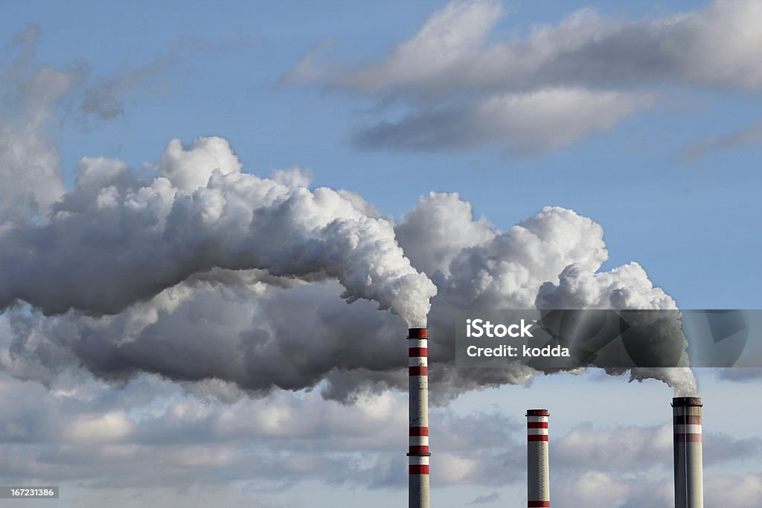
Defination of Poiiution
When Harmful Substances Contaminate the Environment, it is Called pollution.
Pollution refers to the very bad condition of environment in terms of quality and quantity.
figure:01

Slide 4
Air Pollution What is Atmosphere
Atmosphere is the life blanket of Earth.
It is therefore essential that we know more about the atmosphere and the ways in which it is polluted.
Air is considered safe when it contains no harmful dust and gases.
Effects of Air Pollution
Human Health
Animal.
Plants.
The Atmosphere as a whole.

Slide 5
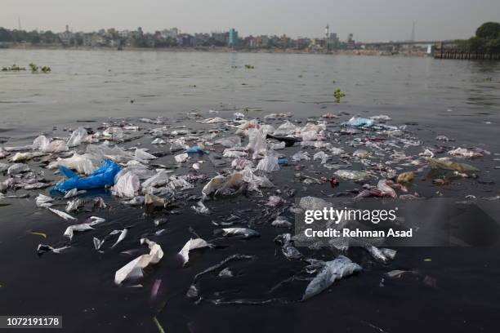
Water pollution
Any physical (temperature, Oxygen), chemical (mercury), or biological (disease, sewage) change to water that adversely affects its use by alive beings.
Figure:02

Slide 6
Effect of Water pollution
Diseases like Cholera, Malaria, Typhoid (spread during the rainy season).
How to Avoid Water Pollution
Rivers should not be used for washing clothes or bathing animals in.
Harvesting of Rainwater to meet water requirements.
Dams and embankments must be created.
The river must be contaminated.

Slide 7
conclution
Today, all over the world there is a great concern and worry as to what will become of the earth, considering the inherent effect of the ever increasing environment pollution that has adversely distorted the ecosystem, thereby spurring but the international communities, the government, generation public, cooperate bodies, policy makers, professionals and even politicians to take adequate measures aimed at addressing environmental problems.
Thank You

